Slide 1
Multi GPU training performance
Farhad Navid
Regis university

Slide 2
Introduction
Motivation
Build a Deep Learning server and learn about the hardware aspect of (DL).
Study the effect of Multi Graphical Processing Units (GPU) on training time.
Study the parallelism on GPU’s with different frameworks (Keras, TensorFlow, PyTorch,..).
Start with Data parallelism on Multiple GPU.

Slide 3


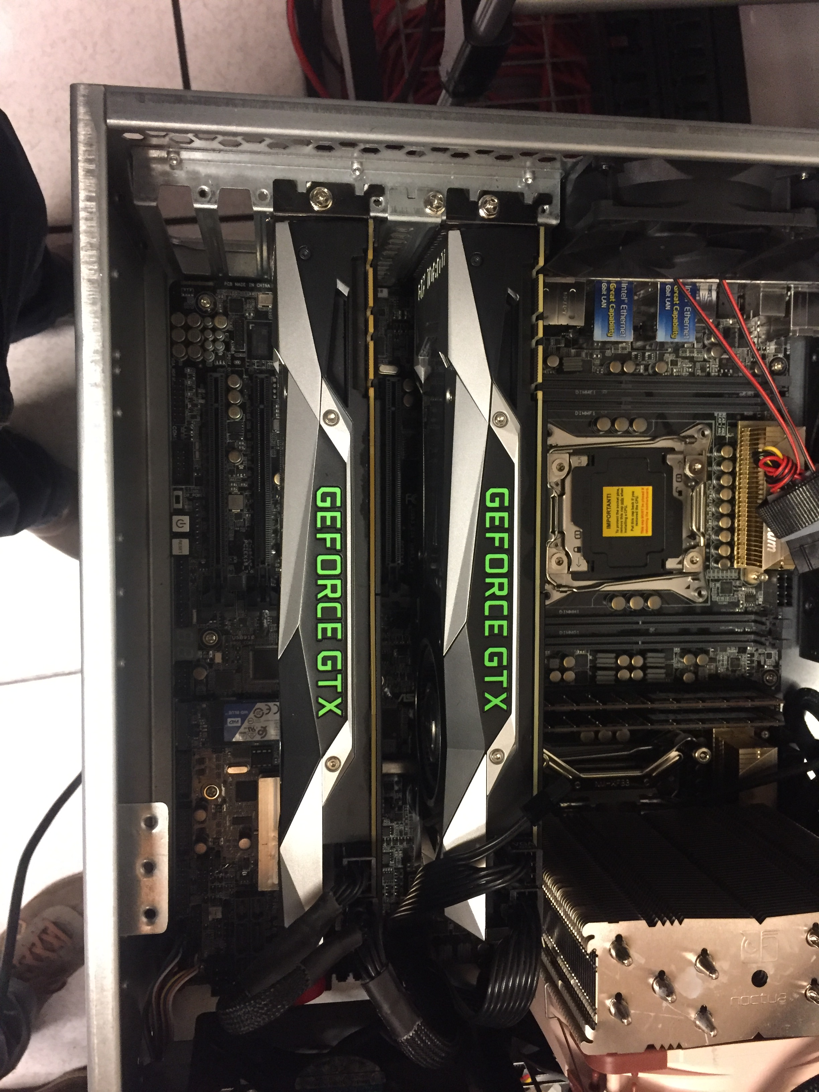
System Configuration (Hardware)
Mother Board: Z10PE-08WS. (Dual Xeon processor, PCIe 3.0)
CPU: Xeon E5 V4 2620. (8 core, 16 treads with 20 meg of fast buffer)
RAM: 128 G DDR4 2133 MHz speed.
SSD: M.2 1TB (NVMe Seq R/W 3.4/2.8 GB/s and IOPS R/W 500/400 K)
NVIDIA GFORCE 1080 TI (11 G DDR5X MEM 484 GB/s BW, 3584 CUDA core)
10 TB HDD, 7200 RPM with 256 M buffer Helium SATA 6G/s
1300 W power supply
4U Rack Mount Chassis. 15 HDD bay

Slide 4
Part selection Consideration
Mother board, expandability, PCIe 3.0 ready, Fast SATA (NVMe or NVMe Express), # of PCIe slots.
CPU: Power , Cache size ( min 2 Meg / GPU), Core/Tread, Cost, DDR4 memory speed.
Memory. Fastest Mother board and chipset can handle ( min 2133 0r 2400 MHz)
SSD Fast boot device. Min 512 GB 1 or 2 TB preferred. The IOPS and seq through put.
GPU: Affordability, reasonable: RTX 2070 TI and Gfroce 1080TI, Good performance RTX 2080 TI.
HDD, Cost, Power consumption and transfer speed. 10 TB sweet spot now.
Power Supply: depending on number of GPU (3X250 + 200 mobo = 950. ) 1300 Watt EVGA

Slide 5
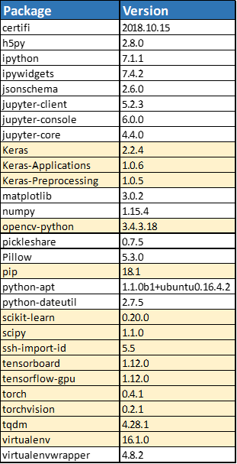
System Configuration (Software)
OS Ubuntu 16.04.5 LTS
Python 3.5.2
Pytorch 0.4.1
Nvidia Driver 384.130
CUDA V9.0.176
OpenCV 2.4.9.1

Slide 6
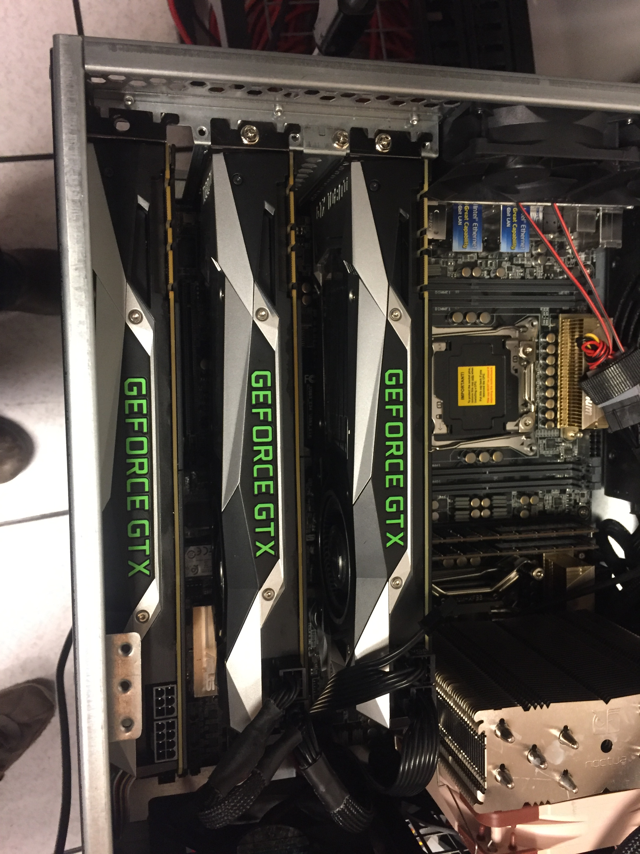
Issues and considerations
Starting point
Ubuntu 18, Python 3.7, TensorFlow 1.12, Keras 2.2, CUDA 10.0.
Failed to run sample models.
Changed OS Ubuntu 16, Python 3.5, CUDA 9.0 (recommended)
Base models to verify the functionality. One GPU
Keras previous Practicum on one GPU. Installed various Python Libs.
TensorFlow used some examples from the GitHub.

Slide 7
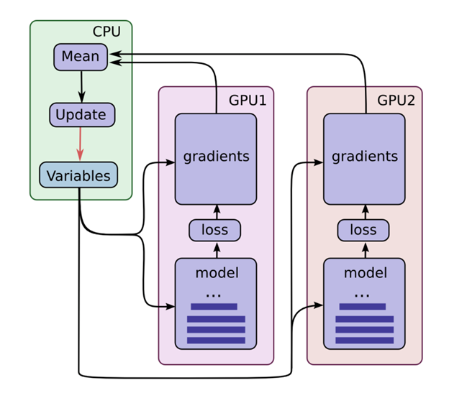
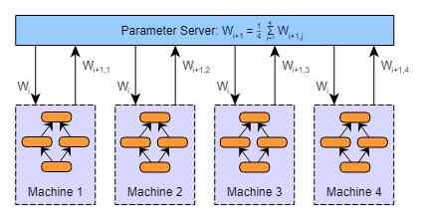
Data Parallelism
The Model Copied on all GPUs or Distributed Systems,
Each GPU gets a different portion of the data.
The Results from each GPU are combined.
Parameter averaging Simplest approach (In-Graph replication)
Initialize the model parameters (Weights, biases)
Distribute Copy of parameters to all GPU’s
Train with subset of Data (b size 128, on 2 GPU 64 each)
Global Parameter to average each GPU’s parameters.
Repeat Steps 2-4 while there is data to process.
Issues with Parameter averaging
Averaging frequency is generally done with a period Usually 1 minibatch or greater.
Every iteration: significant over head increases on data communication.
Infrequent averaging: local parameter may diverge resulting may a poor model after averaging.
Some preliminary research * suggest with about ~10 mini batch can have a reasonable performance at the cost of reduced Model accuracy.
Use of optimization (Adam, RMSProp, …) in each model necessitates averaging at the cost of increased network transfer. Resulting in a better convergence.

Slide 8
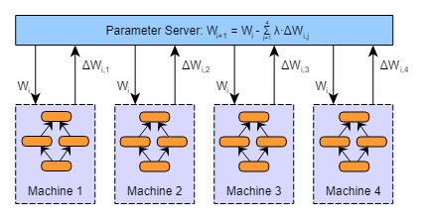
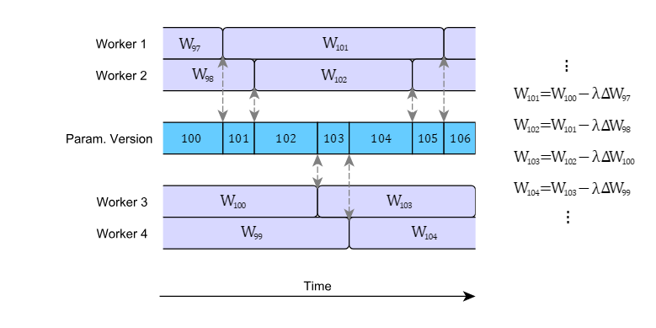
Data Parallelism cont.
Optimization Base averaging preferred approach (Between-Graph replication)
Similar to the parameter averaging. Use the Gradient post learning rate, instead of parameters from model.
The Synchronous averaging holds true for for all optimizers such as SGD (Stochastic Gradient Decent).
l=1/n. where n number of GPUs
Potential downfall :
Large number of GPU’s delays the update lowers the speed, if the GPU are not the similar can cause delay in updating.
Updating Asynchronous Update as soon as the parameters are ready.
For n GPU on average the gradient on average could be N step out of date prior to adding to global parameter vector.
Benefit : Gain higher throughput, Speed up the parameter updates.
Downfall Stall Gradient:
High gradient stall Slow Down the network convergence.
Learning efficiency drops.
There are various solutions for minimize the effect ( such as soft sunc, limit the staleness.

Slide 9
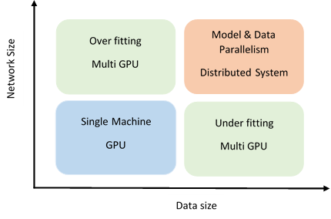
How to determine when to use the parallelism.

Slide 10
Mnist data set Multi GPU
This example is one of the training examples from GitHub. Modified the Code to use the convolution network from Deep Learning class.
Data set shape (28 X 28 X1), 60000 training and 10000 test set.
Batch Size 128 for 1 GPU
Batch Size 64 for 2 GPU
20 Epochs is used in both case.
Model Has about 2354250 parameters
In the two GPU case when printed the model it shows the Concatenate layer Uses the parameter averaging techniques.
1 GPU test accuracy 99.3% training time 240 sec
2 GPU test accuracy 99.3% training time 154 sec

Slide 11
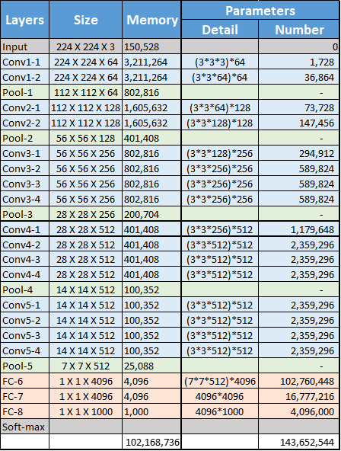
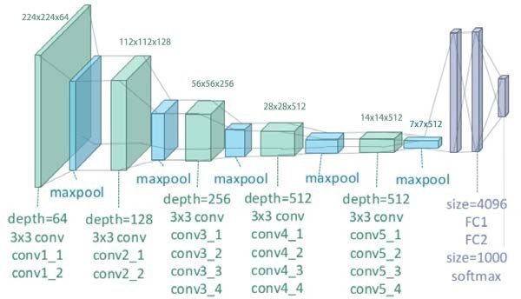
CIFAR 10 data set VGG19 model
CIFAR-10 dataset shape (32x32x3) images in 10 classes.
There are 50000 training images and 10000 test images.
with 6000 images per class.
143 M parameters
Memory usage for 32x32x3 input about 44 MB ( this is approximation w no bias)
Batch size 128, Epoch 200
Update Epoch 100, 150
Loss = Cross Entropy
Optimizer = SGD (LR=.1, weight decay= .0005, momentum= .9, gamma=.1)
Synchronous SGD averaging for Multi GPU.
Reaches the accuracy of 83%
1 GPU training time 2952 sec
2 GPU training time 2296 sec

Slide 12
Next steps
Acquire a reasonable chassis that fits 4 GPU. Repeat the experiments.
Model parallelism
Study the PyCuda framework and compare with TensorFlow, Keras, PyTorch,..).
Study the c-CUDA and understand the customization of the kernels improve efficiencies.
Distributed system. Can build a second server and implement a combine model and data parallelism. (useful for large network and larger data set).

Slide 13
Knowing what I know Now
Define the task more precisely.
Use only one example larger model with large data set(CIFAR-100) and work through the different aspect of data parallelism.
Compare the frameworks implementation and comments on the result.
Maybe Play with c CUDA implementation and compare with other framework results.

Slide 14
Conclusion
Small Data set and small network the improvement in training time utilizing two GPU is about 1.6 improvement (248.3/154.2).
Larger Network and larger size dataset. The improvement was 1.3 (49:12/38:16),
The majority of the over head in both cases could be attributed
Communication between the GPU and CPU for parameter averaging.
Some inefficiency due to the binary file of TensorFlow was not compiled for Xeon CPU. Identified a resource to compile the TensorFlow for Xeon processor.

Slide 15
References
Chen, K., & Huo, Q. (2016). Scalable training of deep learning machines by incremental block training with intra-block parallel optimization and blockwise model-update filtering. 2016 IEEE International Conference on Acoustics, Speech and Signal Processing (ICASSP). doi:10.1109/icassp.2016.7472805
Gupta, S., Zhang, W., & Wang, F. (2016, December 5). Retrieved from https://arxiv.org/pdf/1509.04210.pdf
Su, H., Chen, H., & Xu, H. (2015, July 1). [1507.01239] Experiments on Parallel Training of Deep Neural Network using Model Averaging. Retrieved from https://arxiv.org/abs/1507.01239
Zhang, W., Gupta, S., Lian, X., & Liu, J. (2016). Staleness-aware async-SGD for distributed deep learning. In Proceedings of the Twenty-Fifth International Joint Conference on Artificial Intelligence (IJCAI'16), 2350-2356. Retrieved from https://arxiv.org/pdf/1511.05950.pdf.
https://www.tensorflow.org/tutorials/images/deep_cnn
https://pytorch.org/tutorials/beginner/blitz/data_parallel_tutorial.html

